Slide 1
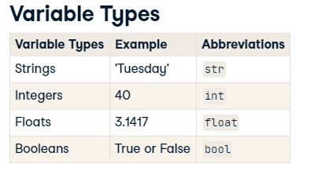
Notes:
4 data types are available in python

Slide 2
To do
Notes:
Model interperation adjusted R squared (not mentioned in udacity)
Statquesy videos on statistics
Medium articles from jesse
Showcase a project that u have worked on
Correlation and why p value is silly
Datacamp regression in python
Extensive pandas exercise also tips and tricks for pandas
Python for data analysis book
Introduction to statistical learning in R chapter 3
AWESOME LINKS
PYTHON ONE LINERS
Show youtube video m kmal
Consider talking about interactions
Andrew NG regression
Hypthesis testing tom
Get libraries that can do logisitic regression and present tables easily using python as well as R
U can mention validation set

Slide 3
Agenda
Analytics vs stats vs ml
Walk through

Slide 4
Stanford teasers
Kaggle competitions exploratory data analysis

Slide 5

What is the purpose ?
انتي جاية اشتغلي ايه؟
Notes:
Data
Aim

Slide 6
Classification vs prediction
Fill from statistics fellowship

Slide 7
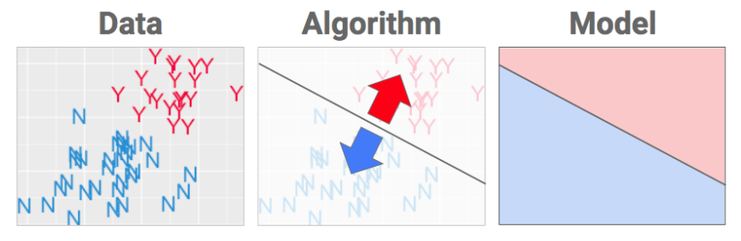
classification
Notes:
The algorithm defines WHAT shape will get fitted to the data. The data is used to choose WHERE the best place for that fence is. (“The best” is another way of saying that our answer comes by doing optimization: math that’s all about finding extremes… like the extremely most awesomely bestest place to shove a wall.

Slide 8
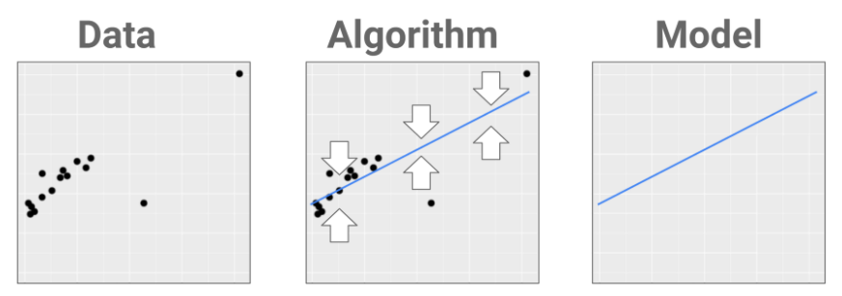
prediction
Notes:
If classification is about separating data into classes, prediction is about fitting a shape that gets as close to the data as possible.
The object we’re fitting is more of a skeleton that goes through one body of data instead of a fence that goes between separate bodies of data.
As before, the algorithm gives you the WHAT and the data gives you the WHERE. When new datapoints come in, they’re plugged into the recipe and the predicted value is read off the line. Want to know more about how that works?

Slide 9
Regression??
“our team used logistic regression to perform classification.
Notes:
It creates confusion, since the term “regression” is still used in ML/AI the way centuries of statisticians have used it: to refer to a class of algorithms (not tasks). As a result, we get sentences like “our team used logistic regression to perform classification.” *heads explode*

Slide 10
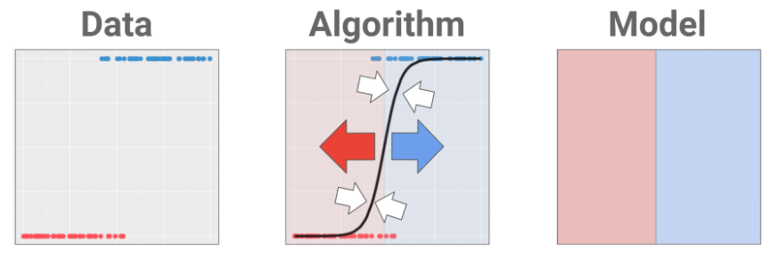

Slide 11
Statistics vs machine learning

Slide 12

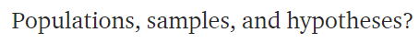
Statistics

Slide 13

Default action

Slide 14


Notes:
Search for aliens on a planet ur manager is waiting for a report that has only this.
Yes or no

Slide 15

Notes:
Oxygen left
U won’t be able to discover the whole planet
Uncertainty
What if I didn’t find info, shall I answer with yes or no?

Slide 16
Default action
Notes:
U can choose any.
In fact it is an MBA question that has to deal with decision maker not with numbers
It is a decision taken while relaxing on a coach

Slide 17

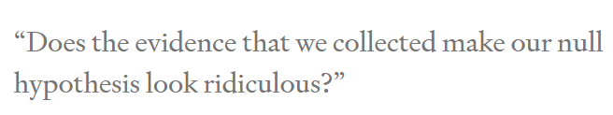
Alternative action
Notes:
If u choose NO as the default action or null hypothesis
Then u won’t choose yes except if data makes pressing no feels ridiculous

Slide 18
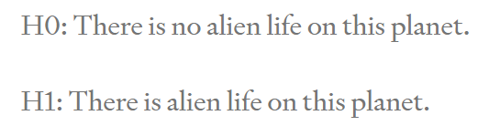

Slide 19



Collect data
Notes:
Thus no aliens on planet
Is it fair ?
U could have missed an alien that u didn’t see

Slide 20


Statistics

Slide 21
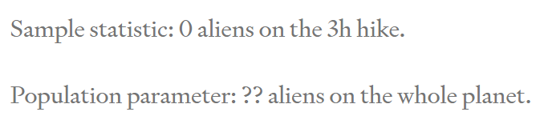
What did we learn?

Slide 22
What did we learn?
What about analytics?
Notes:
Analytics can very easily find interesting results as we simply examine the sample only

Slide 23
Notes:
Medical oncology doctors
Search for a significant p value

Slide 24
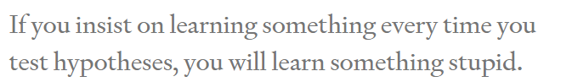
bako5ty

Slide 25
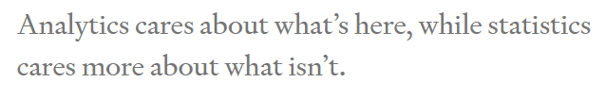
Notes:
One golden rule for analytics.
Stick to the data and don’t go beyond

Slide 26
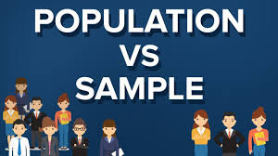
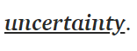
Notes:
Prof tom
The estimate is not the important thing
How confident are u with the estimate

Slide 27
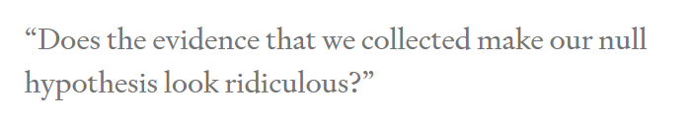
When to change mind?
Notes:
Making decisions based on facts (parameters) is hard enough as it is, but -curses!- sometimes we don’t even have the facts we need. Instead, what we know (our sample) is different from what we wish we knew (our population). That’s what it means to have uncertainty.

Slide 28

Notes:
Supposing it’s an alien not anything else
Found an alien

Slide 29
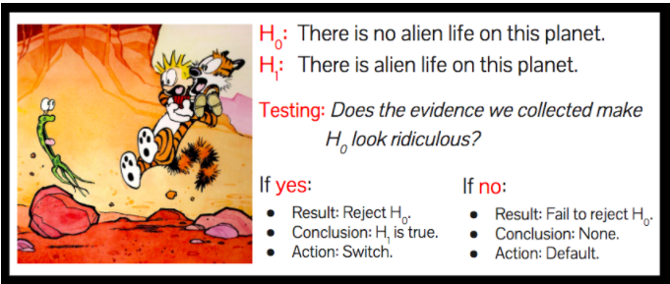
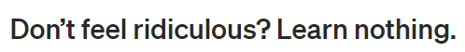

Slide 30
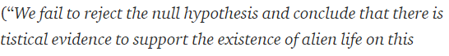


Slide 31

Notes:
Tragedy for learning nothing
We were not here to learn. We were here to take actions.
We have taken a sensible action based on data. We choose the wisely selected default action

Slide 32



Notes:
Why do the stats from the beginning ?
We could have laid down and choose the dafault button
Because u have actually worked hard, in a fairly manner, attempting to change ur mind if u get enough data.
Thus when u choose the default action now, u choose it wenta dameerak merta7
Ma3 enak 3aref en mmken yekoon kararak ghalat (uncertainty) bs this is the best u can do
And that’s why it is always good to increase sample size
To recude type 1 and type 2 errors

Slide 33
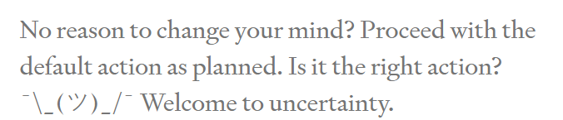

Slide 34
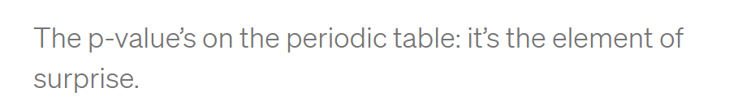

Notes:
The lower the p value
The more yelling at me
Leave the default action
How to measure yelling?
Compare to a preset significance level
This level determines how much risk u tolerate to take
If u set it to zero
U refuse to leave the default action
Don’t do statistics

Slide 35
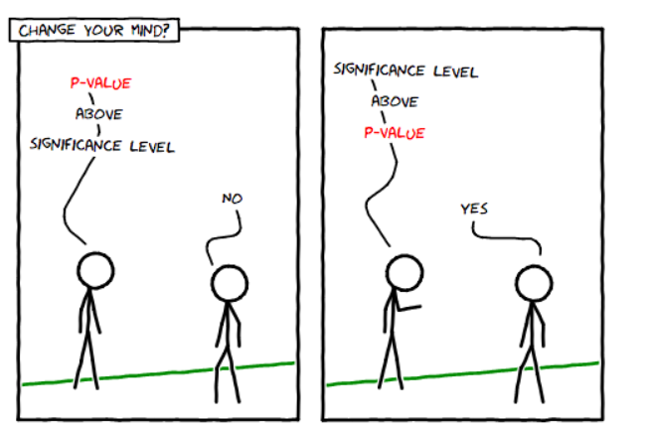

Slide 36
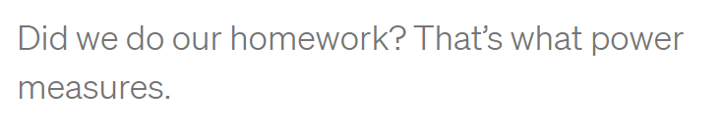

Notes:
3 hours were not enough
What about 30 sec
Easy to stick to default action, but results would be misleading
U didn’t do ur hw
The more u have the more opportunity u have given urself to change ur mind if that’s the right thing to do

Slide 37


Notes:
Why not spend 1000000 hours
Balance between money and effort and time and benefit

Slide 38
Type I and ii errors

Slide 39
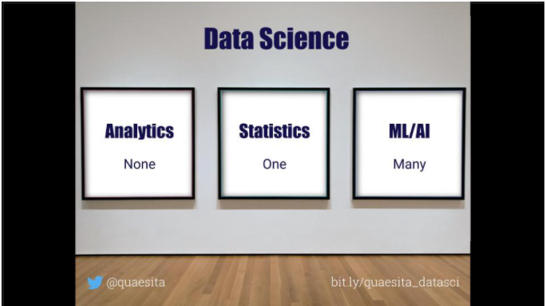
Notes:
How can each discipline influence outside world?

Slide 40
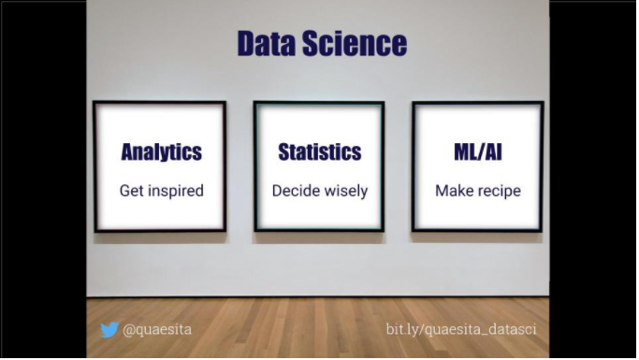

Slide 41
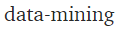
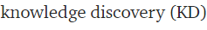
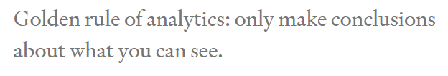

Analytics

Slide 42
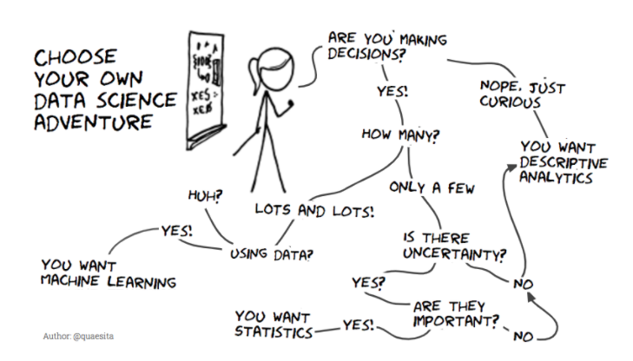
Notes:
Ur fingers are hovering over the launch button for an ai system and u need to check if it works before launching, then call a statistician

Slide 43

How to start?

Slide 44
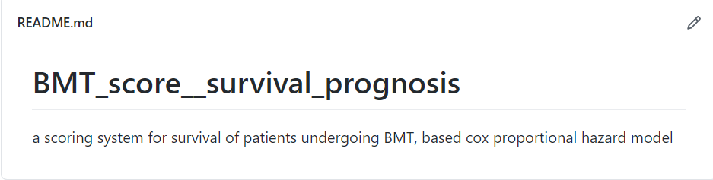

Slide 45


Slide 46
Project walkthrough

Slide 47
How to start?
The objective is to use the energy data to build a model that can predict the Energy Star Score of a building and interpret the results to find the factors which influence the score.

Slide 48
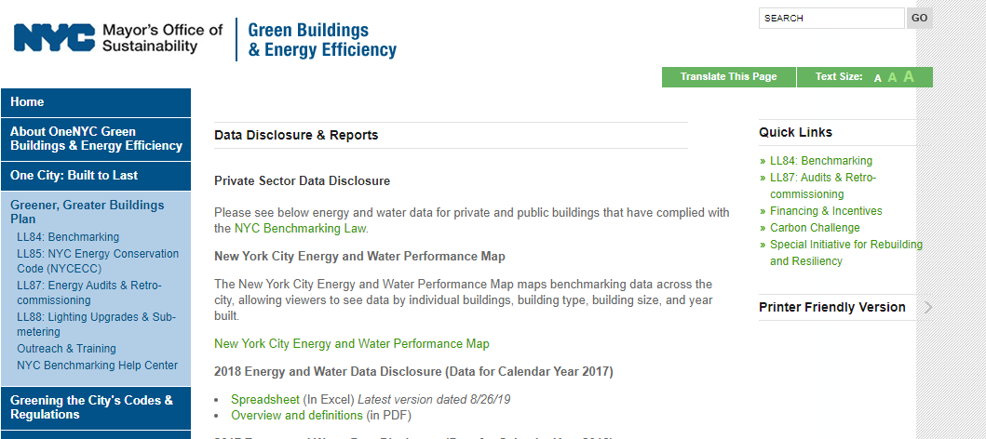

Slide 49
What we have got?
Do u have the label? Outcome ? And features? What is its nature?
Notes:
Supervised
Regression

Slide 50
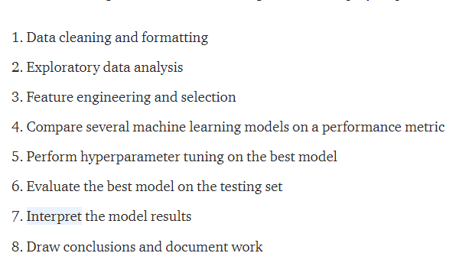
Machine learning
Notes:
For the data analysis process we can do we 1st two
We can not generalize
Consider No one and many article

Slide 51
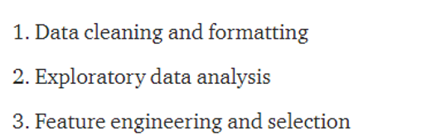
Data analysis

Slide 52
Analysis fast and not generalizable
Statistics p values
Machine learning
Exhaustion of data cassie

Slide 53

Notes:
Analytics only then its exhausted
Statistics … then u have to have a hypothesis to test and a default action null hypothesis
Machine learning divide train and test set
Also validation

Slide 54
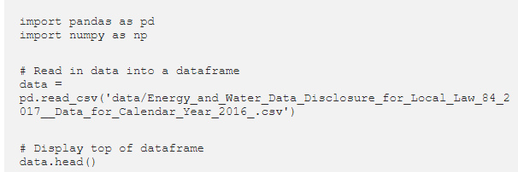

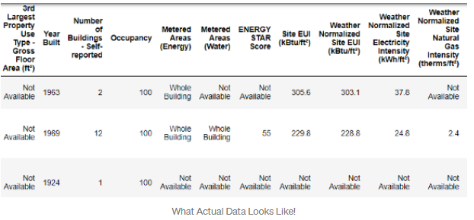
Notes:
Head : top 5 by default

Slide 55
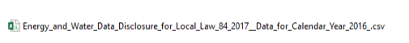
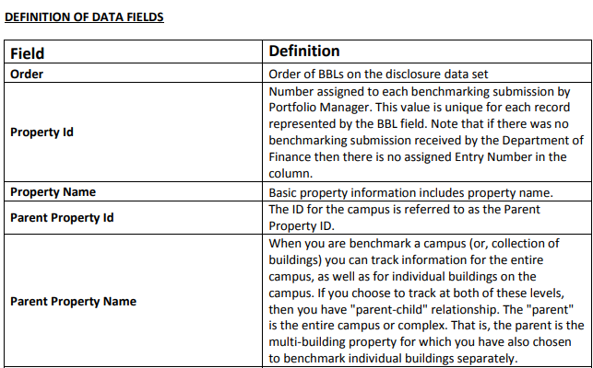
Tidy?
Notes:
He is on an interview

Slide 56
A 1-to-100 percentile ranking based on self-reported energy usage for the reporting year. The Energy Star score is a relative measure used for comparing the energy efficiency of buildings.

Slide 57

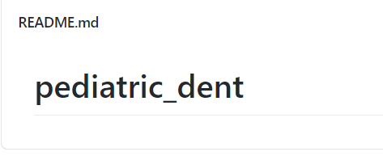
Cleaning
Notes:
How much work is done in cleaning?

Slide 58
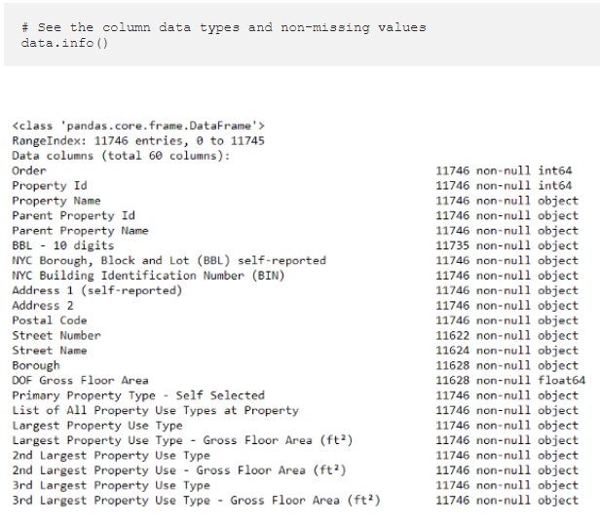
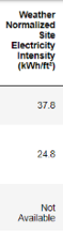
Notes:
Not available means the column will be encoded as a string
Pandas converts a column with any strings into a column of all strings.
Watch the object instead of float

Slide 59
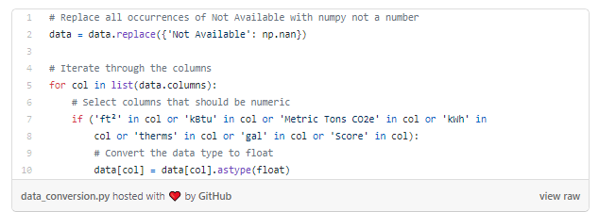

Slide 60
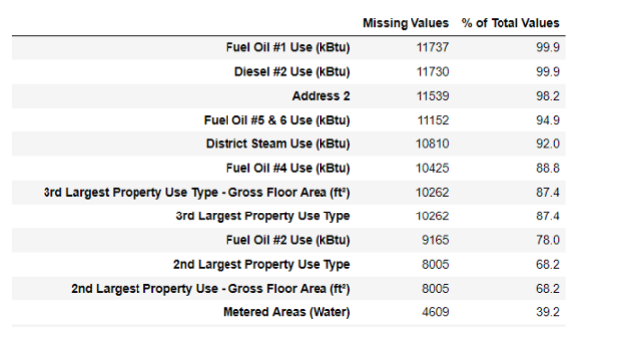
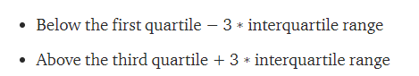
Missing Data and Outliers

Slide 61
Exploratory Data Analysis

Slide 62
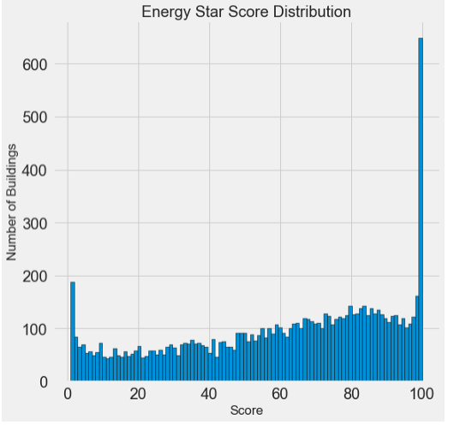
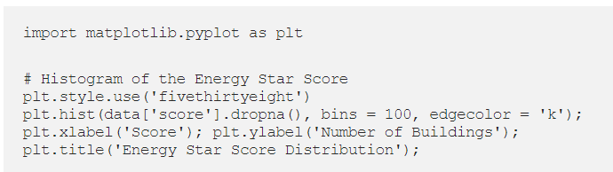
Single Variable Plots
Notes:
Why so many have a score of 100?
Self reported – percentile score for the building
Leeh mas7elsh nafsy hena, w a7awel aktashef leh reported keda? Off topic

Slide 63
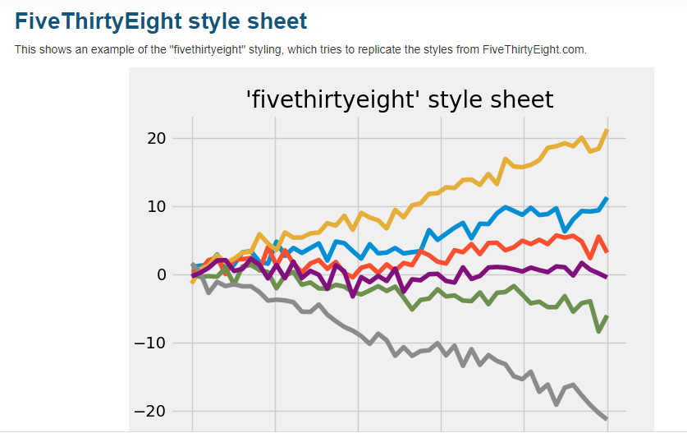

Slide 64
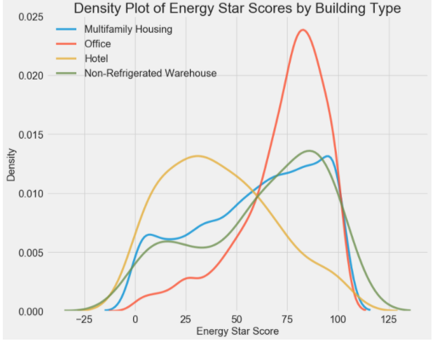
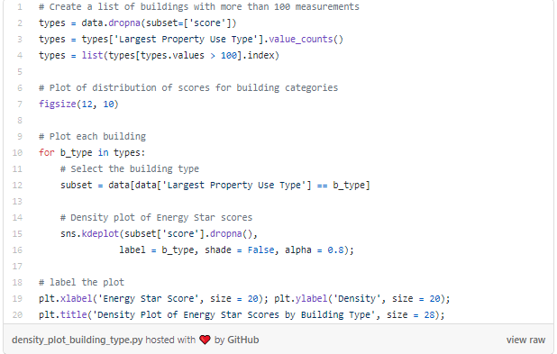
Relationships between variables
Notes:
A density plot can be thought of as a smoothed histogram because it shows the distribution of a single variable. We can color a density plot by class to see how a categorical variable changes the distribution.
We can see that the building type has a significant impact on the Energy Star Score. Office buildings tend to have a higher score while Hotels have a lower score. This tells us that we should include the building type in our modeling because it does have an impact on the target. As a categorical variable, we will have to one-hot encode the building type.

Slide 65
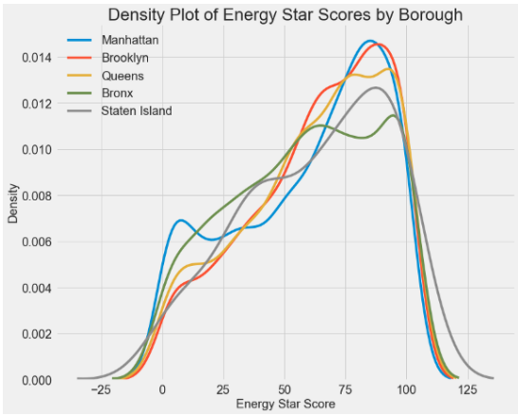
Notes:
The borough does not seem to have as large of an impact on the score as the building type. Nonetheless, we might want to include it in our model because there are slight differences between the boroughs.
منطقة إدارية

Slide 66
correlation

Slide 67
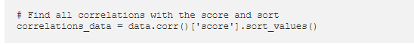
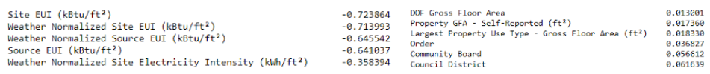
Notes:
There are several strong negative correlations between the features and the target with the most negative the different categories of EUI (these measures vary slightly in how they are calculated). The EUI — Energy Use Intensity — is the amount of energy used by a building divided by the square footage of the buildings. It is meant to be a measure of the efficiency of a building with a lower score being better. Intuitively, these correlations make sense: as the EUI increases, the Energy Star Score tends to decrease.

Slide 68
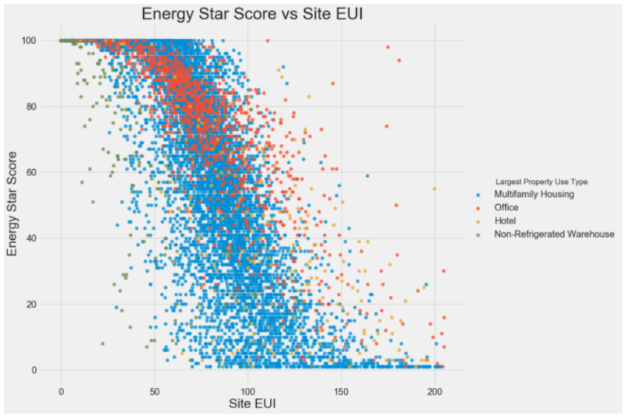
Notes:
As the Site EUI decreases, the Energy Star Score increases, a relationship that holds steady across the building types.

Slide 69
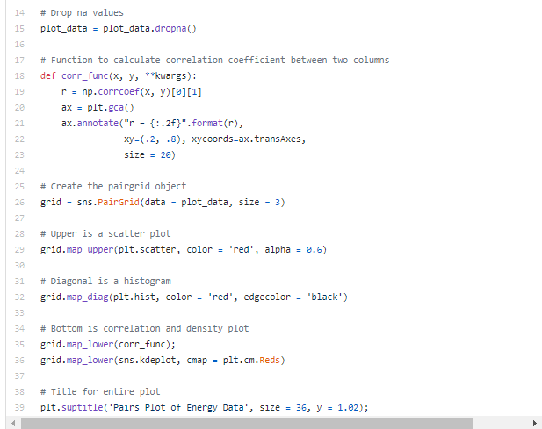


Pairs plot
Notes:
we look in the Weather Norm EUI row and the score column and see a correlation coefficient of -0.67

Slide 70

linear relationship

Slide 71

Faster ??

Slide 72



Slide 73


Slide 74



Slide 75


Slide 76





Slide 77


Slide 78

Feature engineering
Notes:
The following code selects the numeric features, takes log transformations of these features, selects the two categorical features, one-hot encodes these features, and joins the two sets together. This seems like a lot of work, but it is relatively straightforward in Pandas!

Slide 79

Feature Selection
Notes:
known as collinear and removing one of the variables in these pairs of features can often help a machine learning model generalize and be more interpretable. (I should point out we are talking about correlations of features with other features, not correlations with the target, which help our model!)

Slide 80
Establishing a Baseline
mean absolute error
Andrew Ng’s advice to pick a single metric and then stick to it when evaluating models. The mean absolute error is easy to calculate and is interpretable.
Notes:
For regression problems, a reasonable naive baseline is to guess the median value of the target on the training set for all the examples in the test set. This sets a relatively low bar for any model to surpass.

Slide 81
Splitting
Cassie

Slide 82

ML vs stats

Slide 83
Stat repo BMT

Slide 84


Notes:
The naive estimate is off by about 25 points on the test set. The score ranges from 1–100, so this represents an error of 25%, quite a low bar to surpass!

Slide 85

How to choose?

Slide 86

Imputing Missing Values

Slide 87

Feature Scaling
Normalization
Standardization
Notes:
Methods such as support vector machines and K-nearest neighbors that take into account distance measures between observations are significantly affected by the range of the features and scaling allows them to learn
While methods such as Linear Regression and Random Forest do not actually require feature scaling,
subtracting the minimum value of the feature, and dividing by the maximum minus the minimum (the range). This specific version of scaling is often called normalization and the other main version is known as standardization.

Slide 88

Implementing Machine Learning Models in Scikit-Learn
Notes:
U can simply change from one model to the other

Slide 89

Notes:
To put these figures in perspective, the naive baseline calculated using the median value of the target was 24.5. Clearly, machine learning is applicable to our problem because of the significant improvement over the baseline!

Slide 90
Cross validation

Slide 91
Gradient Boosted Methods
Notes:
While a bagging algorithm such as random forest trains the weak learners in parallel and has them vote to make a prediction, a boosting method like Gradient Boosting, trains the learners in sequence, with each learner “concentrating” on the mistakes made by the previous ones.
The Scikit-Learn implementation of Gradient Boosting is generally regarded as less efficient than other libraries such as XGBoost , but it will work well enough for our small dataset and is quite accurate.

